Slide 1

The Team:
Producer:
Juli Gregg
Game Designer:
Luke Conlon
Tech Director:
Dan Muller
Project Manager:
Kaden Nugent

Slide 2
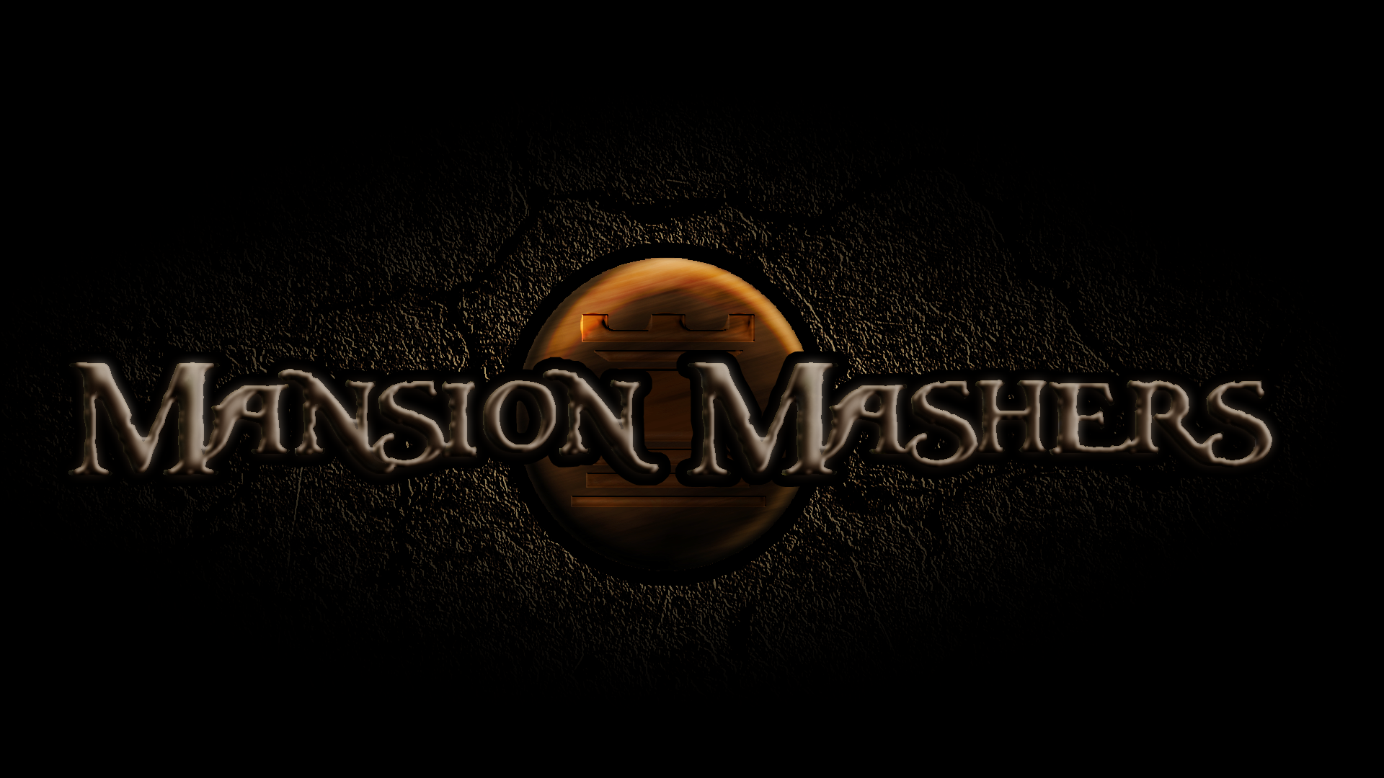

Slide 3

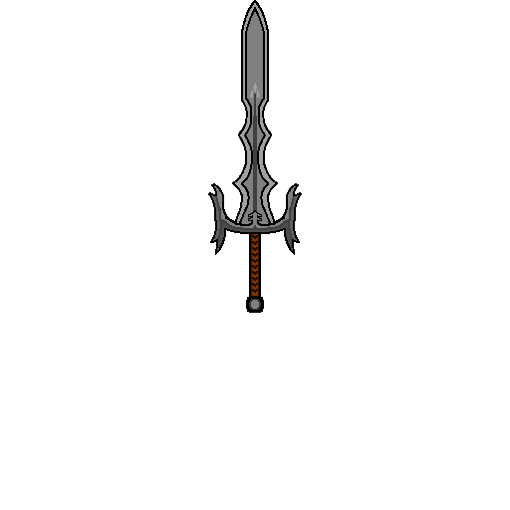
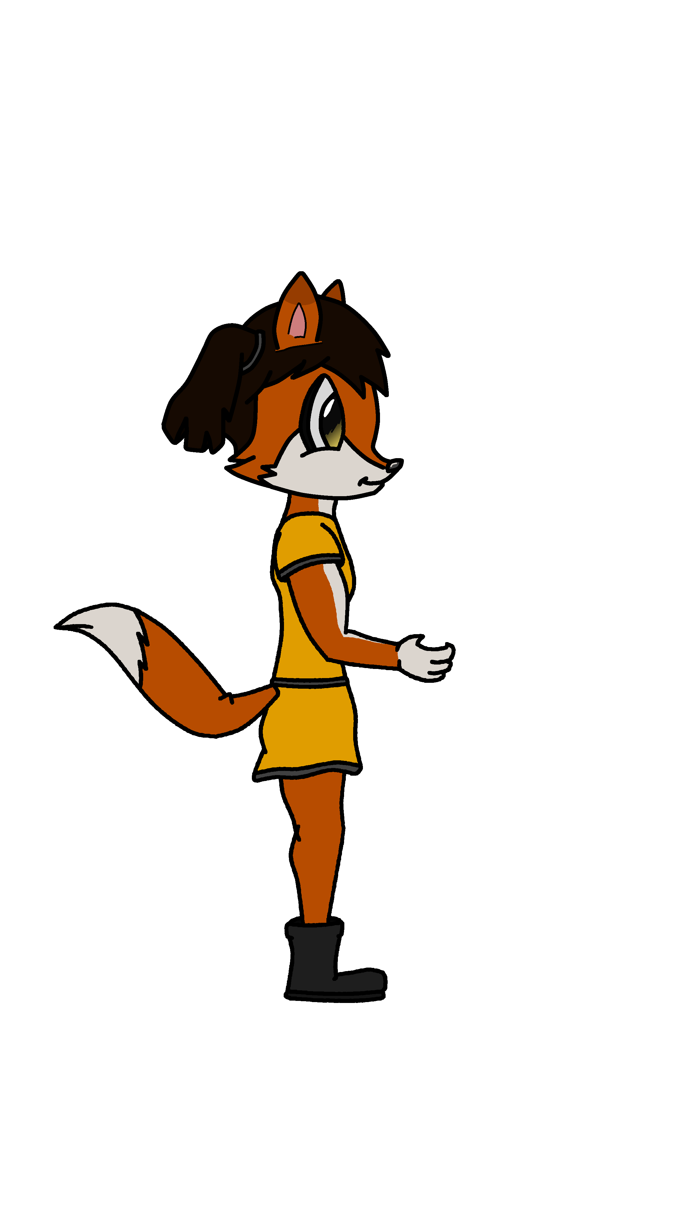
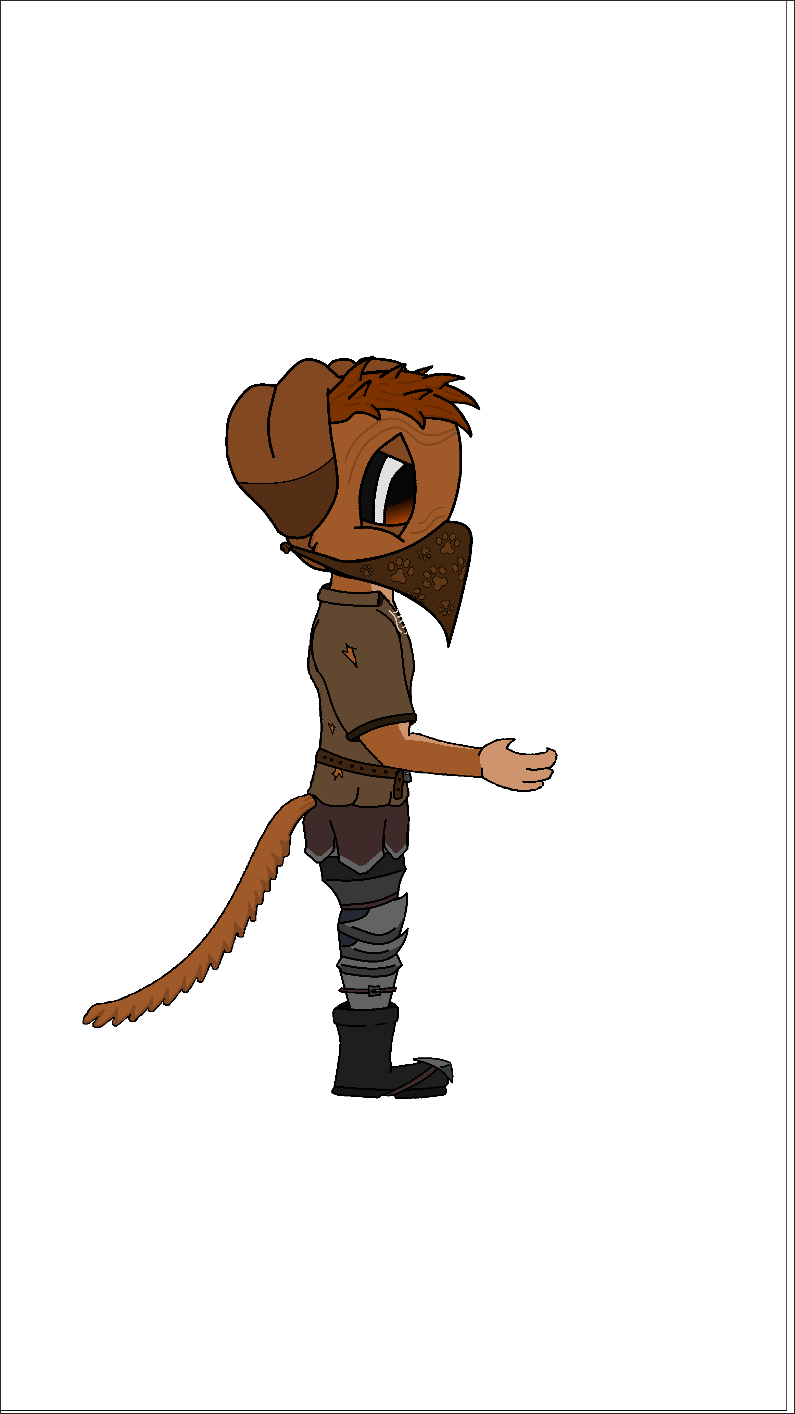
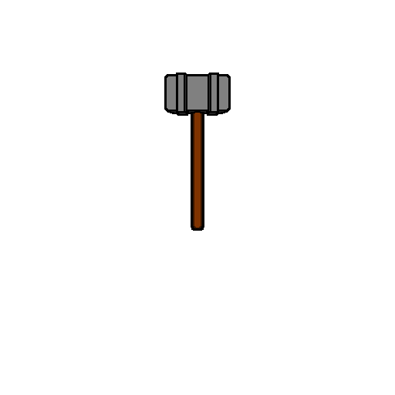

High Concept:
A 2-D fast-paced, side scrolling hack and slash game set in a cartoon fantasy world with character ability progression.

Slide 4

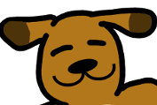
Summary:
Two rival clans:
VS
Play as a mighty princess in
a mission to rescue a captured prince
Save the prince save your clan!

Slide 5

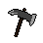
Mechanics:
Translation Based Movement
Minor Platforming
Melee Combat
Scripted Boss Fights

Slide 6
Demo

Slide 7
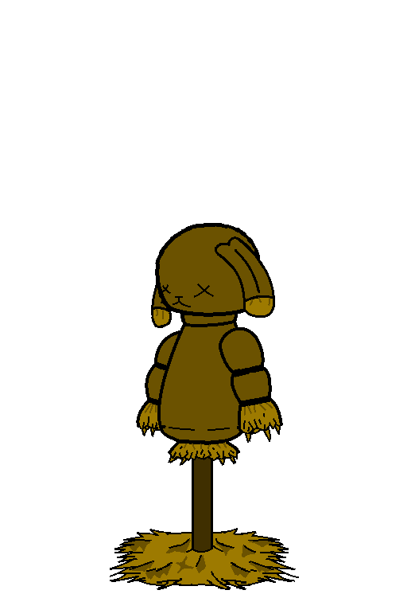
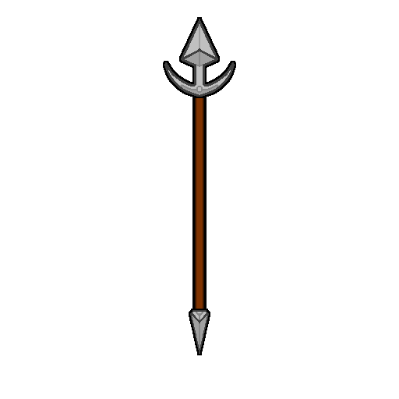
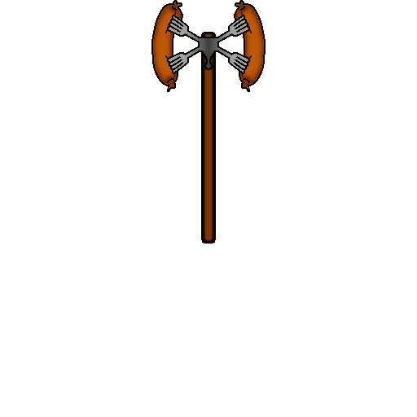
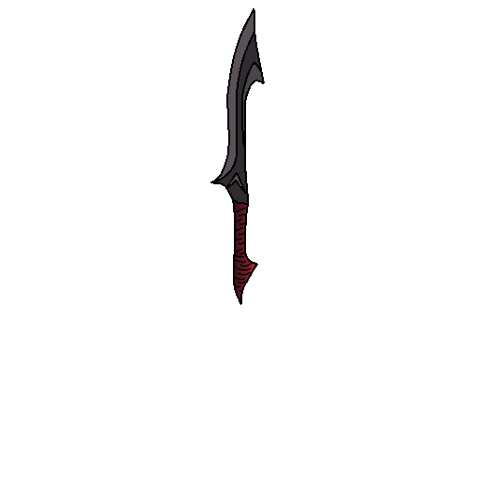
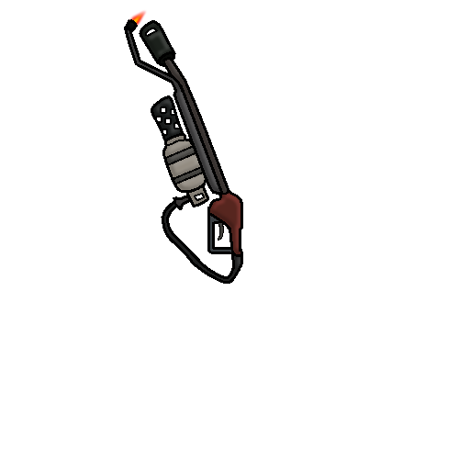
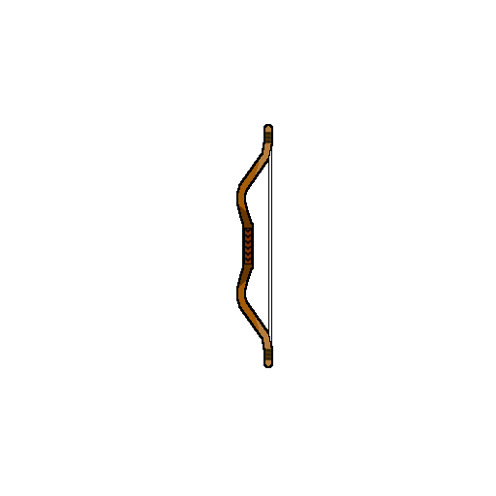
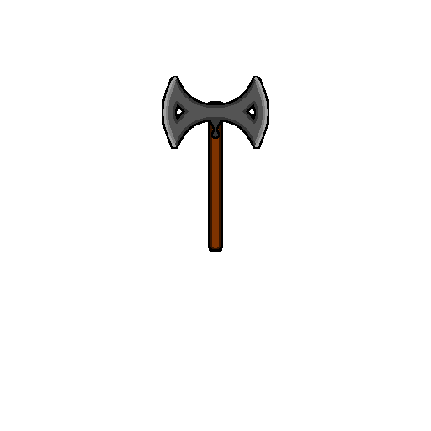
Stretch Goals:
Multiplayer
Cooperative AI Pets
Special Items
More Weapons

